Slide 1
Module 1 Project : Team API - Key
Presented by:
Jeronimo Cagliero
Malika Baguari
Matteo Grossi
Winifred Paul
Notes:
“Good morning everyone, and thank you for joining us today. We are Team API, consisting of Jeronimo, Malika, Matteo, and myself.
Today we'll be presenting our project on identifying strategic opportunities for EV charging infrastructure expansion in Spain.

Slide 2

EcoCharge Mobility Solutions S.L.
Madrid
EcoCharge Mobility Solutions S.L. is a leading EV charging infrastructure provider specializing in the design, deployment, and operation of public charging networks across Europe. Established over a decade ago, the company has successfully expanded its charging infrastructure across several European markets, including Germany, France, Netherlands, and Portugal.
Notes:
"Our client, EcoCharge Mobility Solutions S.L., is a Madrid-based EV charging infrastructure company with over ten years of experience. As electric vehicle adoption continues to grow across Spain, the company wants to identify the best locations to expand its charging network and support future demand."

Slide 3

What Drives Us
Accessibility
Reliable Charging
Sustainable Mobility
Affordable Mobility
Notes:
"EcoCharge's mission is to make electric mobility practical and accessible for everyone. The company achieves this by expanding reliable charging infrastructure, supporting sustainable transportation, and providing affordable, convenient charging solutions that encourage wider EV adoption across Spain."

Slide 4

Where We're Going
01
European Expansion
Expanding our charging network across key European markets to support the growing demand for EV infrastructure.
02
Carbon Reduction
Contributing to a cleaner future by promoting sustainable transportation and reducing emissions.
03
Growing EV Adoption
Enabling the transition to electric mobility by supporting the increasing number of EV drivers.
Notes:
"EcoCharge's ambition is to build a strong EV charging network across Spain, making charging easy and accessible for everyone. By encouraging more people to switch to electric vehicles, the company aims to reduce carbon emissions and support a cleaner, greener future."

Slide 5
Business Challenge and Objective
Business Challenge
Spain's growing EV adoption is increasing demand for charging infrastructure. EcoCharge seeks to identify the most attractive locations for expanding its charging network.
Business Objective
Determine where EcoCharge should expand its charging network to maximize accessibility and support future demand.
Notes:
"Spain is experiencing rapid growth in electric vehicle adoption, creating a greater need for accessible charging infrastructure.
EcoCharge Mobility Solutions plans to expand its charging network across the country.
The objective of this project is to identify the regions, tourist destinations, and travel routes where new charging stations can best support current and future EV demand."

Slide 6
Data Collection Approach
Eurostat Statistics API | Official EU data on EV adoption, vehicle registrations, and alternative fuel trends. Used to assess market demand and EV growth patterns. Endpoint URL *No API key required
Open Charge Map | Charging station location and infrastructure data. Used to evaluate Spain’s current charging network and identify expansion opportunities. Endpoint URL *API key required
Web scraping | We captured recent market developments that helped validate our analysis. We'll share the key finding from this web-scraped article in the next section Python Requests + BeautifulSoup Article
01
02
03
Notes:
"To address EcoCharge's business objective, we combined three data sources.
Eurostat helped us analyse EV adoption and market growth trends.
Open Charge Map provided detailed information on charging station locations across Spain.
Finally, we used Python web scraping to capture recent market developments that were not available through APIs.
Together, these sources gave us both historical data and current market insights to support our analysis and recommendations."

Slide 7
Preparing Data for Analysis
Data Extraction
Data Transformation & Enrichment
Retrieved EV market data from Eurostat
Retrieved charging station data from Open Charge Map
Converted API responses into Pandas DataFrames
Flattened nested JSON structures using json_normalize()
Derived Autonomous Communities from geographic coordinates
Categorized charging stations by accessibility
Data Cleaning & Validation
Data Integration
Removed duplicates and irrelevant columns
Handled missing values and standardized formats
Verified country codes, locations, and data consistency
Combined Eurostat, Open Charge Map, and web-scraped datasets
Created analytical metrics such as EVs per 100,000 inhabitants.
Prepared integrated datasets for visualization and business analysis.
Notes:
"After collecting the data, we prepared it for analysis through four main steps.
First, we extracted the data from the APIs and organised it into datasets.
Next, we transformed the data by adding useful information, such as regions and charging station categories.
We then cleaned the data by removing duplicates, filling in missing values, and ensuring everything was in a consistent format.
Finally, we combined the datasets to calculate key metrics, allowing us to compare EV adoption with charging infrastructure and develop data-driven recommendations."

Slide 8
Data Challenges & Limitations
01
02
Eurostat provides complete EV registration data only up to 2024. Therefore, the analysis is limited to 2020–2024.
Data Granularity : Eurostat provides EV registrations available only at the national level not at the city or provincial level
03
04
Open Charge Map relies on community and partner contributions, meaning station records may vary in completeness and update frequency.
Some charging station records contained missing or inconsistent location information, requiring additional data cleaning and geographic enrichment.
Notes:
"Like any data analytics project, we faced a few data limitations.
Eurostat provided reliable EV data, but it was only available up to 2024 and only at the national level, so regional EV registrations were not available.
We also found that some charging station records from Open Charge Map needed additional cleaning because the data is community-contributed.
We considered these limitations throughout our analysis to ensure our findings and recommendations remained reliable."

Slide 9
Project Findings
Notes:
Let us look at our project findings

Slide 10
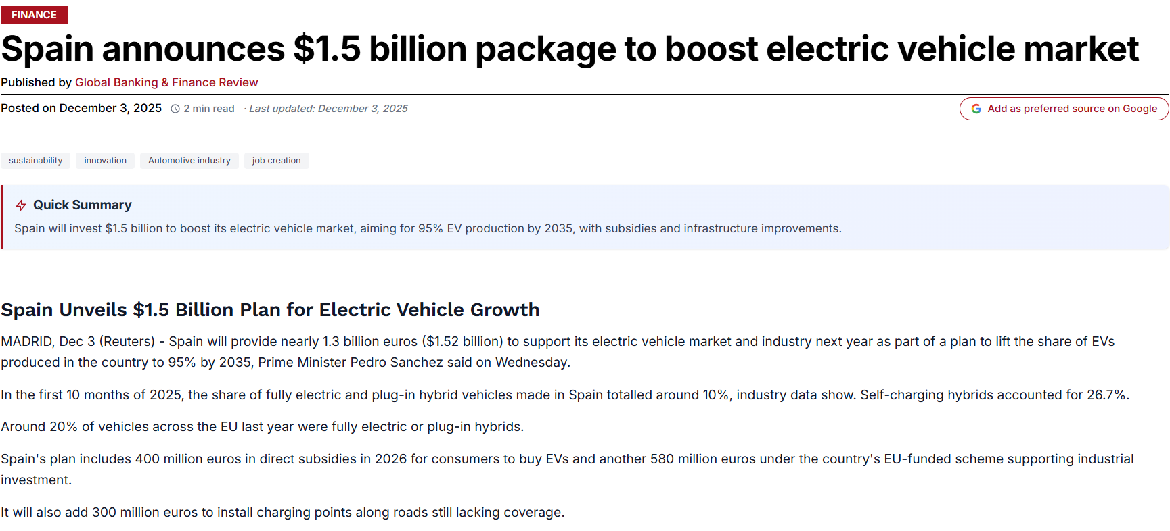
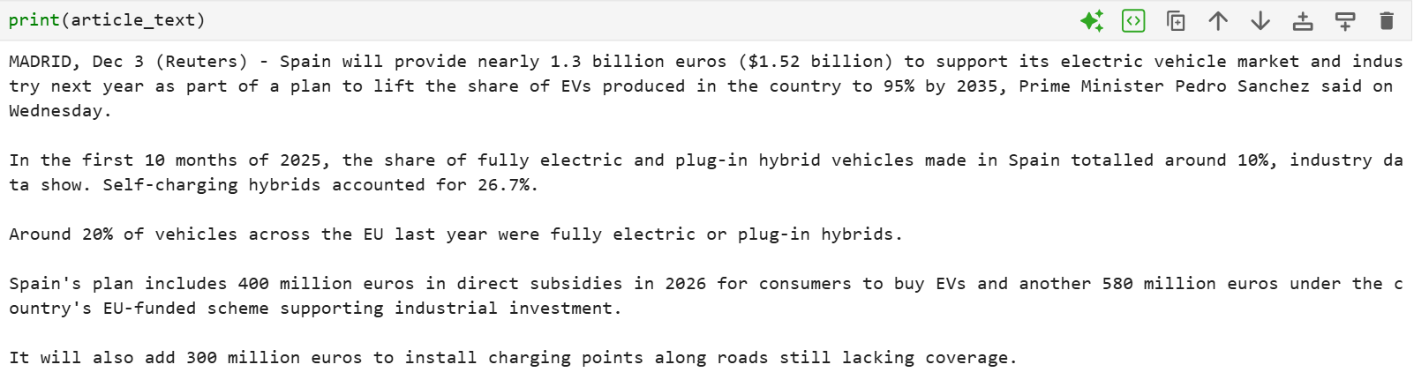
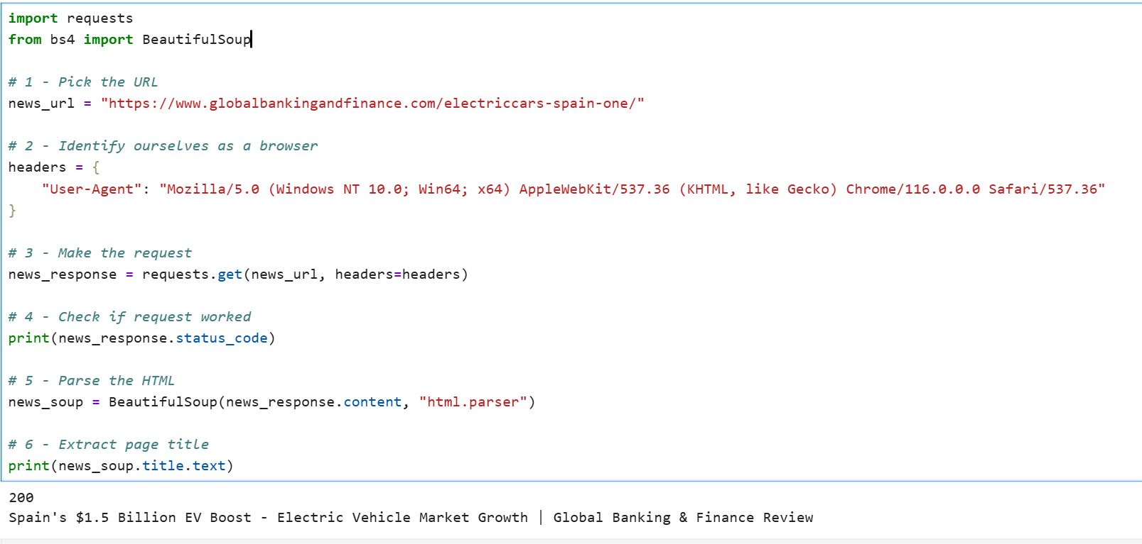
Beyond APIs: Market Intelligence Through Web Scraping
Key Takeaways:
Spain announced a $1.5 billion investment to accelerate the EV market
The package includes funding for EV charging infrastructure
Government incentives are expected to increase EV adoption
Spain aims to keep its position as a leading European automotive hub
These initiatives are likely to drive long-term demand for public charging networks
*Source: Global Banking & Finance Review
Why This Matters to EcoCharge:
Strong government support reduces investment uncertainty
Increasing EV ownership will create higher demand for charging infrastructure
Public funding and market growth make Spain an attractive market for network expansion
Notes:
"Before analysing the data, we wanted to understand the latest developments in Spain's EV market. To do this, we used web scraping to collect information from a recent news article.“ (click)
"The code successfully extracted the article, confirming that Spain announced a $1.5 billion investment package to support the electric vehicle market."
"After extracting the article, we reviewed the content to identify the key business insights.“(click)
"The article highlights five key points. Spain is investing $1.5 billion to accelerate EV adoption. The package includes funding for charging infrastructure, incentives to encourage EV ownership, and support to strengthen Spain's position as a leading automotive hub. Together, these initiatives are expected to increase long-term demand for public charging networks.“
"For EcoCharge, this is important because strong government support reduces investment uncertainty while increasing future demand for charging infrastructure. Overall, these market signals indicate that Spain is an attractive market for expanding EV charging networks."

Slide 11
EV Adoption Continues to Grow in Spain
Key Finding:
Since 2022, Spain has maintained strong EV growth, with annual growth rates above 30%
Spain's EV market continues to expand despite reaching a more mature stage
Business Impact:
More EVs will increase demand for charging infrastructure
Providers must plan for long-term network expansion
Source: Eurostat (2020–2024)
Notes:
"After exploring the market outlook through web scraping, we looked at EV adoption in Spain. The data shows that EV registrations have continued to grow by more than 30% each year over the last three years. Although the market is becoming more established, demand for electric vehicles is still increasing. For EcoCharge, this means more EV drivers will need charging stations, creating strong opportunities for future expansion."

Slide 12
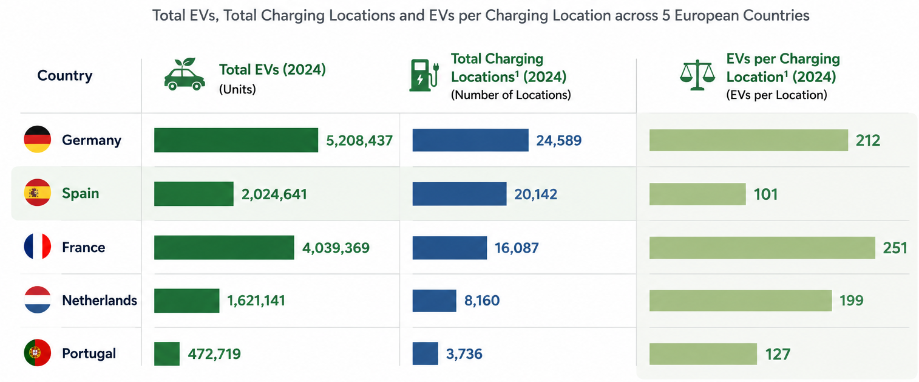
Spain's Charging Infrastructure Keeps Pace with EV Growth
Key Finding:
Spain has the lowest EV-to-charging-location ratio (101) among the five countries
This indicates better charging availability per EV compared with the other countries analysed
Business Opportunity:
Spain's charging infrastructure provides a strong foundation to support continued EV growth
There is capacity to accommodate future growth
Source: Eurostat (2020–2024)
Notes:
"After confirming that EV adoption is growing in Spain, we wanted to see if the charging infrastructure was keeping up.
We compared Spain with four other European countries using the number of EVs per charging location.
Spain had the lowest ratio, with just 101 EVs per charging location, showing that its charging network is well developed.
This gives EcoCharge a great opportunity to expand now, while demand is still growing.
The next step was to identify the regions where this expansion would have the greatest impact."

Slide 13
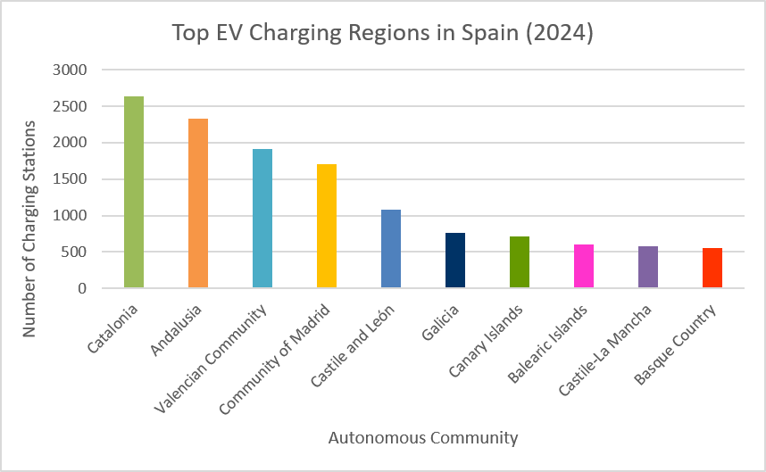
Regions Leading Spain's Charging Infrastructure Growth(2024)
Key Finding:
Spain's EV charging infrastructure is concentrated in four major regions, which together account for a significant share of the national charging network
Business Opportunity:
Prioritize expansion in high-demand EV regions to maximize charger utilization
Strengthen presence in established markets while targeting underserved areas for future growth
Leverage regional demand to increase network coverage and market competitiveness
Source: Open Charge Map
Notes:
Catalonia represents Spain's most mature charging market, while Madrid, the Valencian Community, and Andalusia are maturing markets where growing business activity, tourism, and vehicle demand create opportunities for further expansion
This means charging demand is likely to continue growing, creating opportunities for EcoCharge to expand its network and improve accessibility for both residents and visitors."

Slide 14
Restricted Access Dominates Spain's EV Charging Network
Key Findings:
Only 19% of charging locations are openly accessible
60% require membership or restricted access
Business Opportunity:
Limited accessibility may reduce convenience for tourists and occasional EV users
Public accessibility will become increasingly important as EV adoption grows
Notes:
"We've seen that Spain has a growing charging network, but accessibility is just as important.
Our analysis shows that only 19% of charging stations are openly accessible, while around 60% require membership or restricted access.
This can make charging less convenient for tourists, occasional EV drivers, and first-time users.
This highlights an opportunity for EcoCharge to expand open-access charging in high-demand locations."

Slide 15
Project Recommedation

Slide 16
Strategic Recommendations for EcoCharge
High-Demand Cities
Cross-Border Travel
Finding:
Madrid (1,707) Valencian Community (1,919) already have extensive charging networks and high vehicle volumes
Action:
Expand open-access charging to support continued EV growth and tourism demand
Finding:
Only 6.6% of charging stations are located along the France–Spain corridor despite connecting two of Europe's largest EV markets
Action:
Install fast chargers along key motorway corridors
Improve Accessibility
Create Strategic Partnerships
Finding:
19% of openly accessible charging stations
Approximately 60% require membership or restricted access
Action:
Adopt a balanced network with 40% open-access chargers for tourists and occasional users, and 60% membership-based chargers for businesses and frequent users
Finding:
Madrid and Valencia are among Spain's busiest tourist destinations and major gateways for rental vehicles
Action:
Partner with EV rental companies, hotels, airports, and tourism operators to offer integrated charging solutions
Notes:
"Based on our findings, we recommend four actions for EcoCharge. First, expand open-access charging in high-demand cities such as Madrid, and the Valencian Community, where strong vehicle ownership, tourism, and business activity will continue to drive demand.
Second, adopt a balanced charging model with 40% open-access and 60% membership-based chargers to better serve both occasional and regular users.
Third, strengthen the France–Spain corridor with fast chargers to support cross-border EV travel.
Finally, partner with EV rental companies, hotels, and airports to make charging more convenient for visitors.
Together, these recommendations will improve accessibility, increase charger utilisation, and support EcoCharge's long-term growth in Spain."

Slide 17
Thank you!

Slide 18
Annexure

Slide 19


Reverse Geocoding of EV Charging Station Coordinates
This code uses the latitude and longitude coordinates of each EV charging station to identify its corresponding Spanish province through reverse geocoding. The extracted province information is then added as a new column to support regional analysis and visualization.

